Slide 1
Signal Processing
Tirgul 5 – CC, complex numbers and Fourier transform

Slide 2
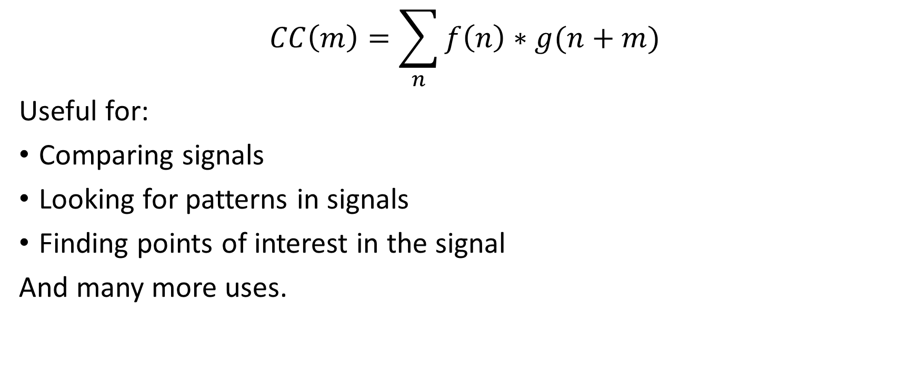
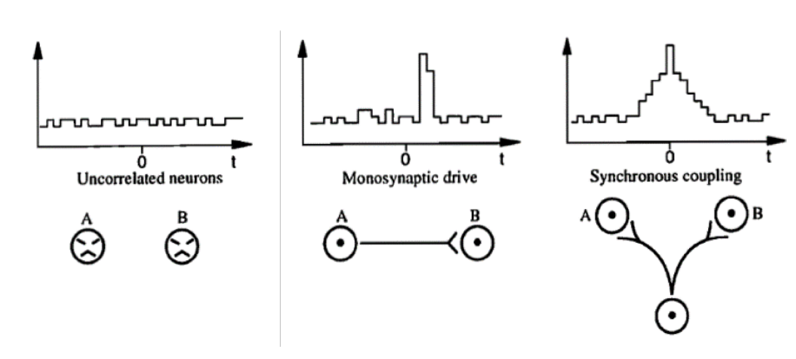
Cross Correlation - connections between neurons
CC results

Slide 3
Cross correlation – Example 1
Draw schematic cross correlation graphs between all 3 neurons in the following network:
A
Excitation
Excitation
B
C

Slide 4
Cross correlation – Example 1
A-B
A
Excitation
Excitation
A-C
B
C
B-C

Slide 5
Cross correlation – Example 2
Draw schematic cross correlation graphs between all 3 neurons in the following network:
A
Excitation
Inhibition
B
C

Slide 6
Cross correlation – Example 2
A-B
A
Excitation
Inhibition
B
C
A-C
B-C

Slide 7
Cross correlation – Example 3
Draw schematic cross correlation graphs between all 3 neurons in the following network:
A
Excitation
Excitation
B
C
Inhibition

Slide 8
Cross correlation – Example 3
A
A-B
Excitation
Excitation
B
C
Inhibition
A-C
B-C

Slide 9
Discrete Fourier Transform (DFT)

Slide 10

Introduction - complex numbers

Slide 11
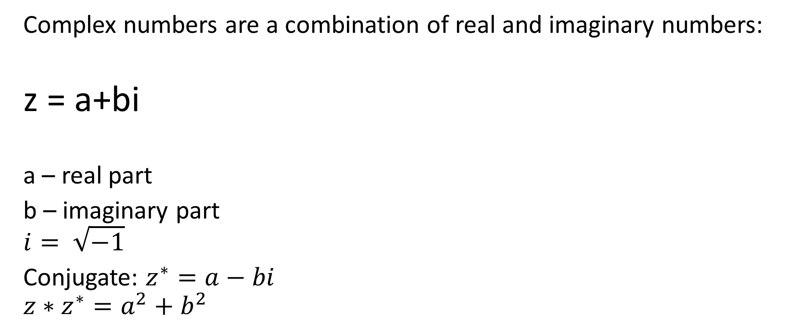
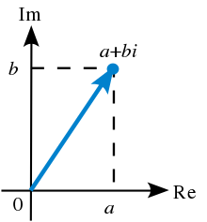
Complex Numbers

Slide 12
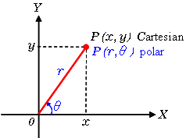
Polar form
Any vector can be represented in a polar form (r, theta), amplitude and angle, or in a cartesian form (x,y)

Slide 13
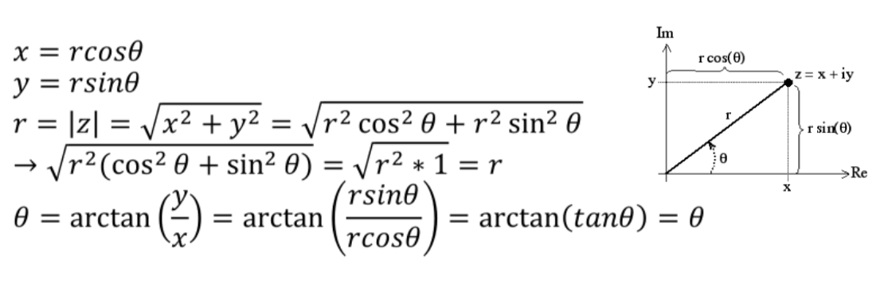
Polar form
Any vector can be represented in a polar form (r, theta), amplitude and angle, or in a cartesian form (x,y)

Slide 14
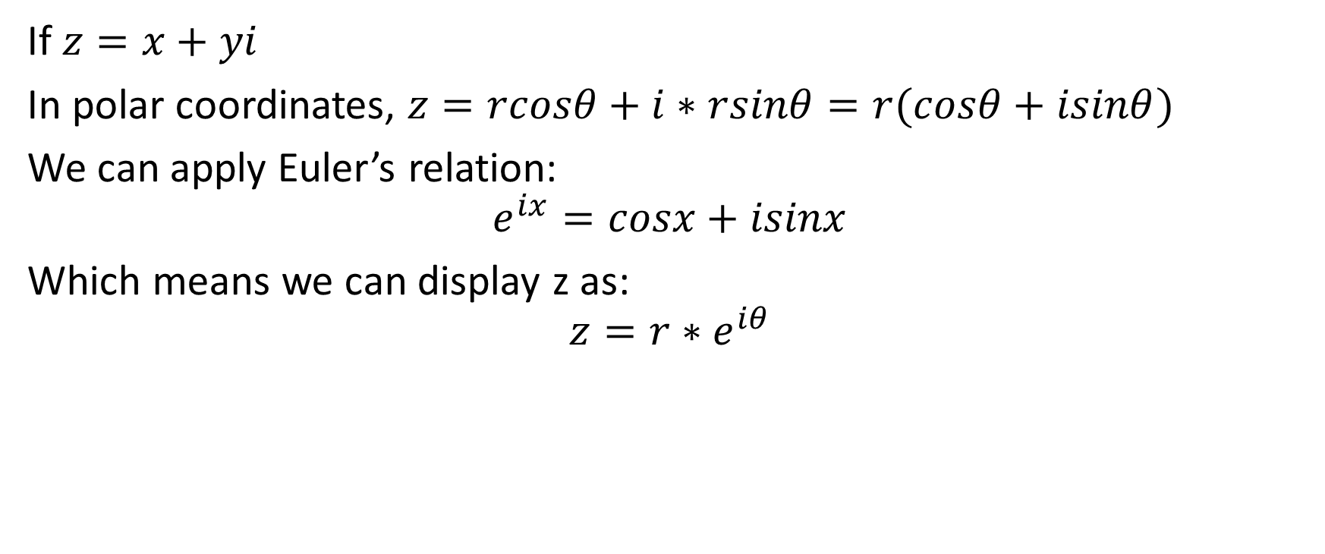
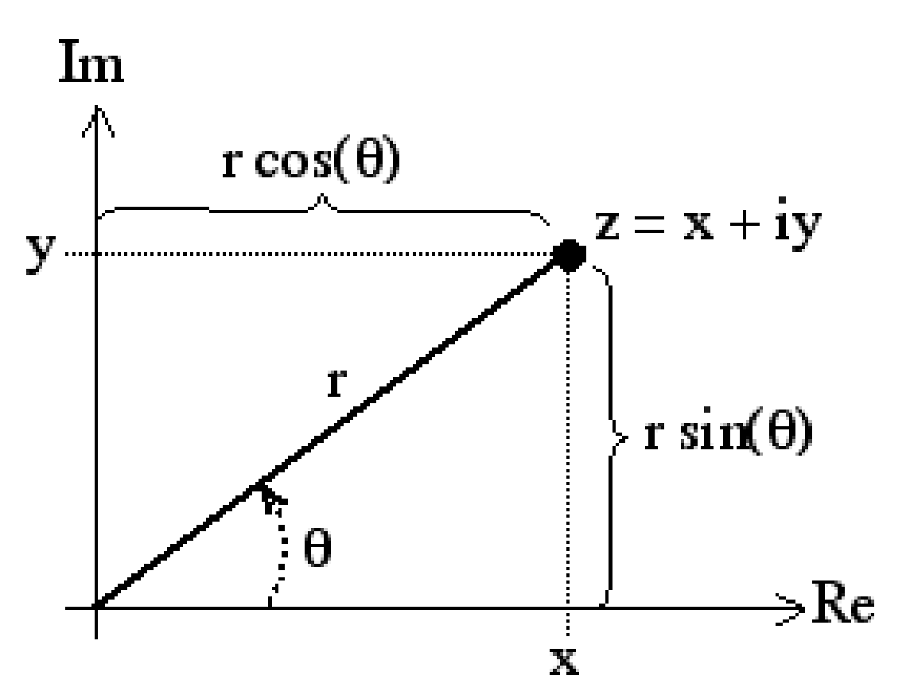
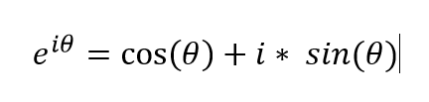

Complex numbers in polar form

Slide 15
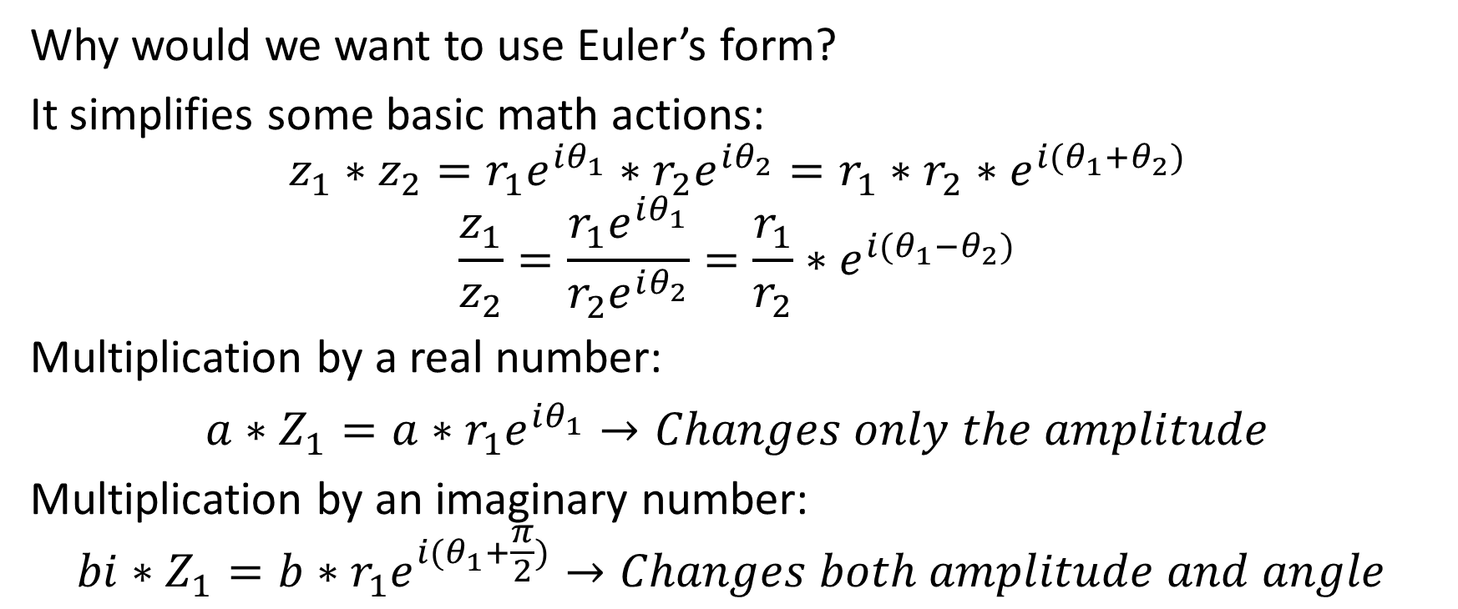
Complex numbers in polar form

Slide 16
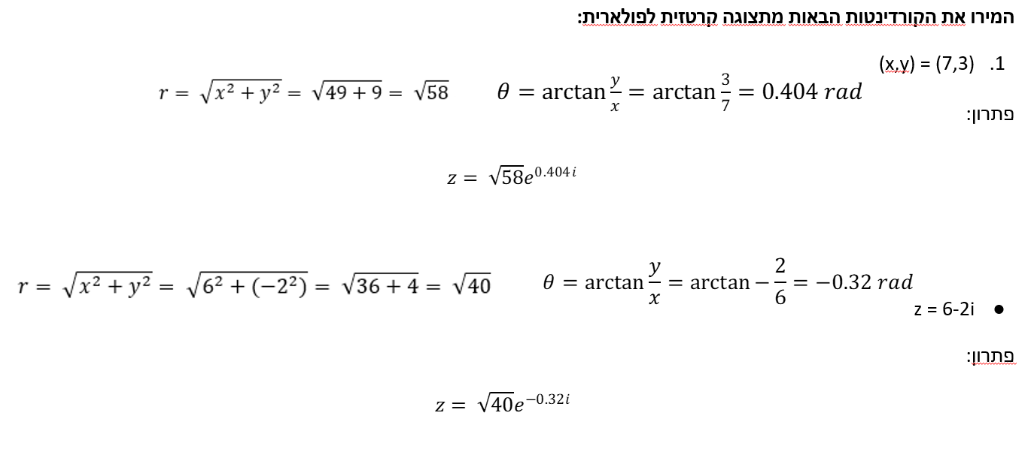
Examples
Notes:
\לשנות את הזווית לרדיאנים

Slide 17
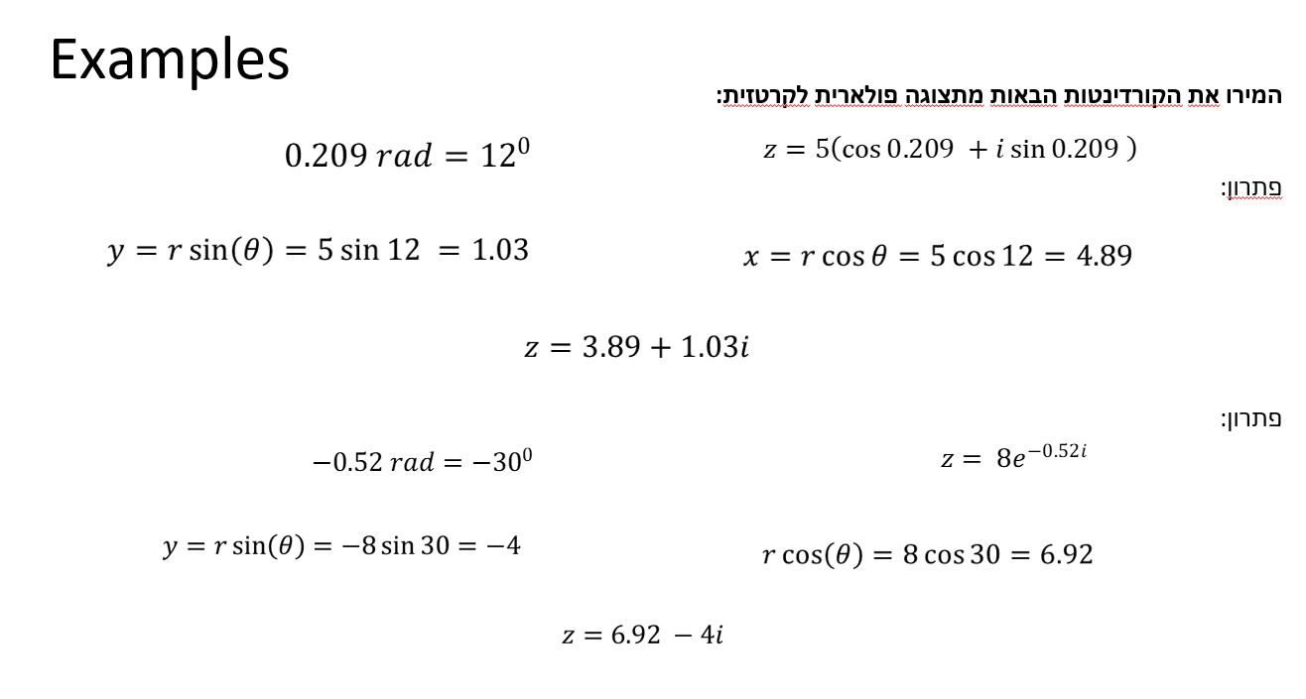

Slide 18
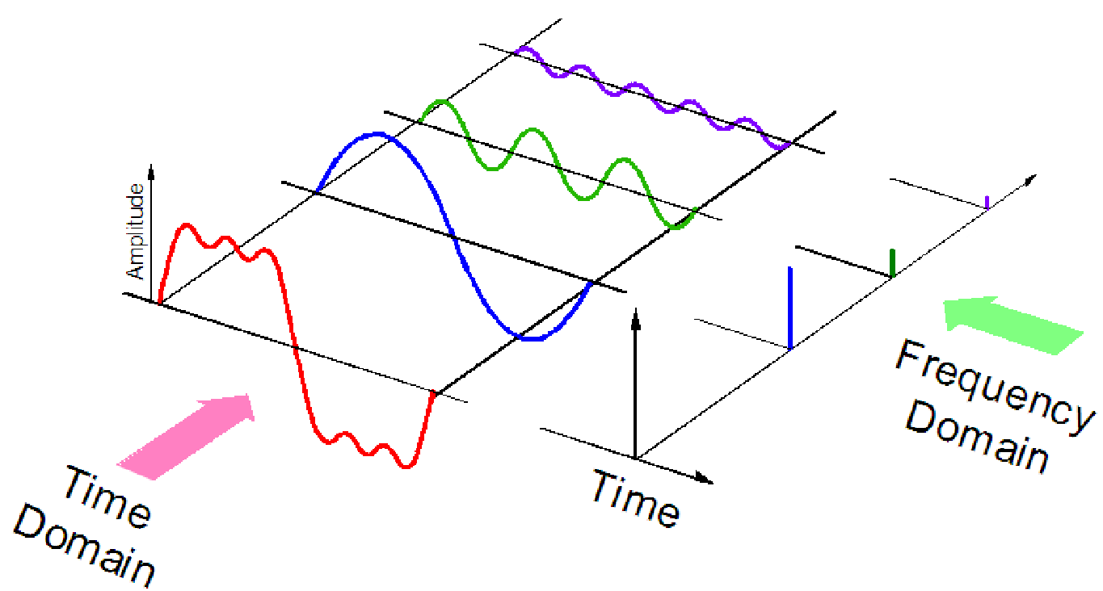
Discrete Fourier Transform (DFT)
The goal of a Fourier transform is to move from the time domain to the frequency domain. Can be accomplished since every signal can be displayed (or estimated) as a combination of sinewaves.

Slide 19

Discrete Fourier Transform (DFT)
The transform is calculated by:
N – Number of sampling points
n – Sampling index (0,1,2,…,N-1)
k - Frequency

Slide 20

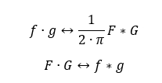
DFT - formulas and features
Inverse:
Convolution and Multiplication
(AKA “Convolution theorem”)

Slide 21


DFT - formulas and features
Parseval
linearity

Slide 22
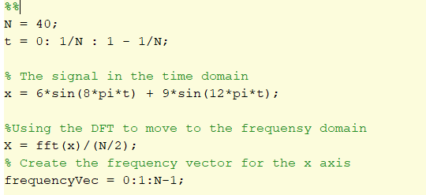
DFT – Matlab example
Notes:
לשנות

Slide 23
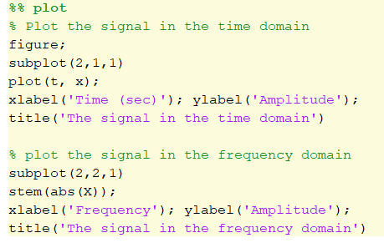
DFT – Matlab example - how to plot

Slide 24

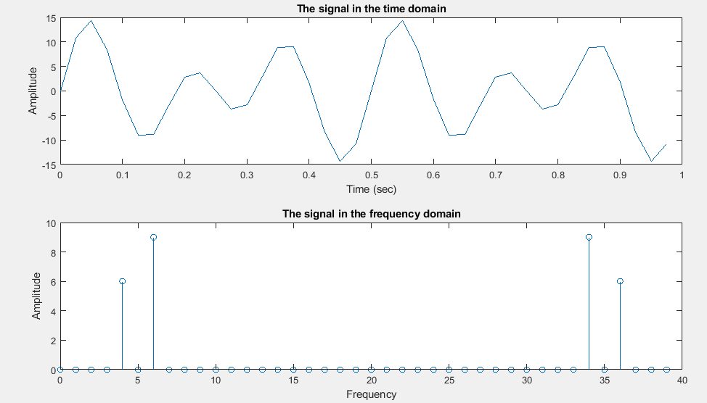
DFT – Matlab example

Slide 25
DFT – online example

Slide 26
DFT – Manual example
Calculate the DFT at 4Hz for the signal x=5*Sin(4*2π), use N=10.
First, we need to find the values of x(n)= 5*Sin(4*2π*n/N):
x(n=0)=0
x(n=1)=5*sin(4*2π*1/10)=2.939
x(n=2)=5*sin(4*2π*2/10)=-4.756
x(n=3)=5*sin(4*2π*3/10)=4.756
x(n=4)=5*sin(4*2π*4/10)=-2.939
x(n=5)=0
x(n=6)=5*sin(4*2π*6/10)=2.939
x(n=7)=5*sin(4*2π*7/10)=-4.756
x(n=8)=5*sin(4*2π*8/10)=4.756
x(n=9)=5*sin(4*2π*9/10)=-2.939
Notes:
?

Slide 27
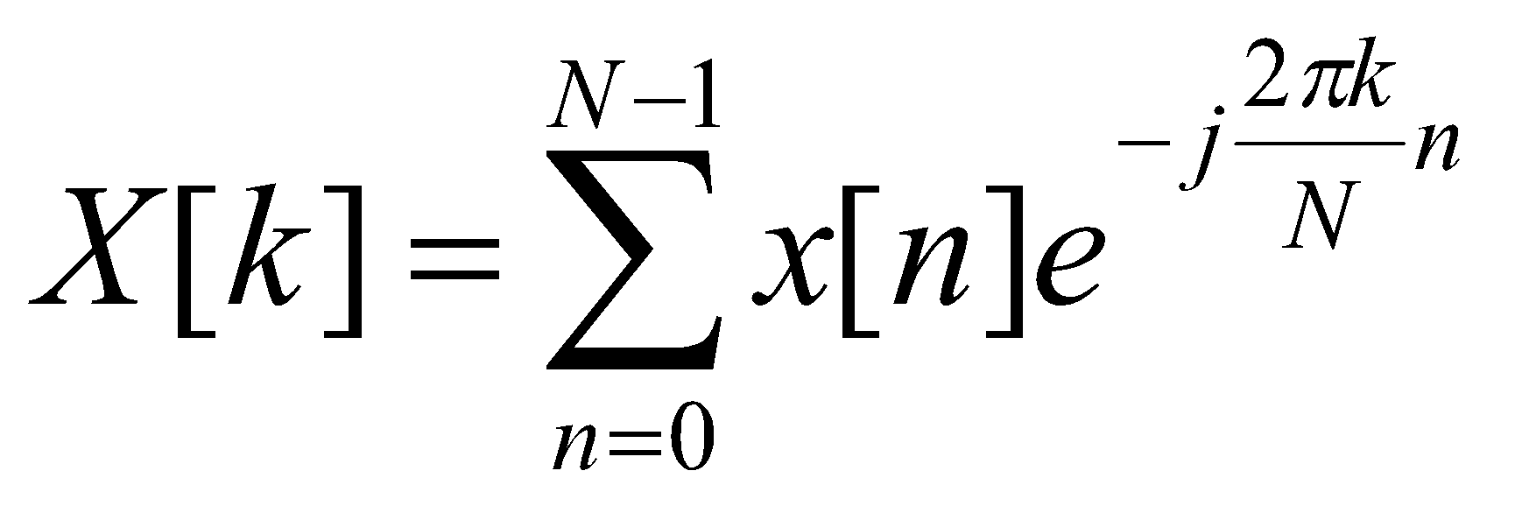
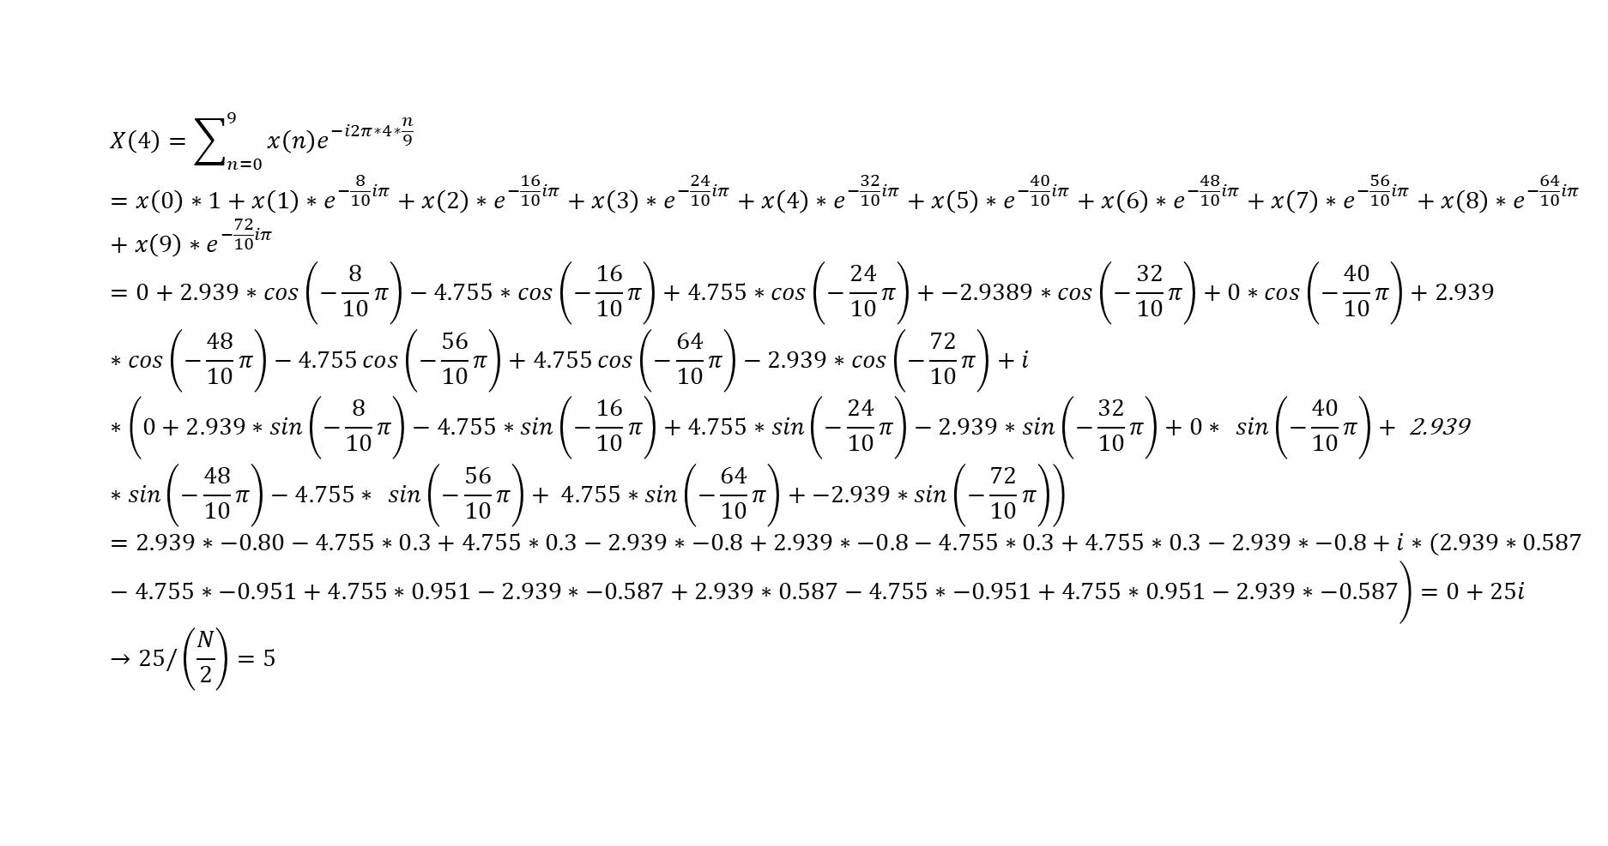
DFT – Manual example

Slide 28
Question:
Assume you computed a 8 points DFT in one second (e.g use t=0:1/8:1-1/8 or t=(0:7)/8) on signal x to obtain X. what you expect the X values to be if (verify with fft in matlab):
a. x=1*sin(2*pi*t*2)
b. x=5*cos(2*pi*t*3)
c. x=2*cos(2*pi*t*2) +2*cos(2*pi*t*1)
d. x=2*cos(2*pi*t*3) -2*cos(2*pi*t*1)
e. x=4*sin(2*pi*t*1)+3*cos(2*pi*t*5) % note the nyquist frequency

Slide 29
Real and imaginary amplitudes
The sine amplitude is represented by the imaginary part of X
The cosine amplitude is represented by the real part of X

Slide 30
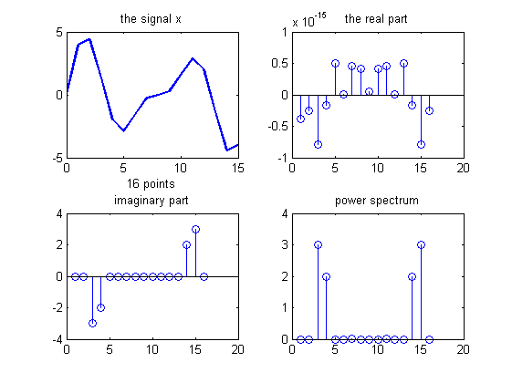
Examples x=3*sin(2*π*2) + 2*sin(2* π*3)
: real(x)
: imag(x)
: abs(x)

Slide 31
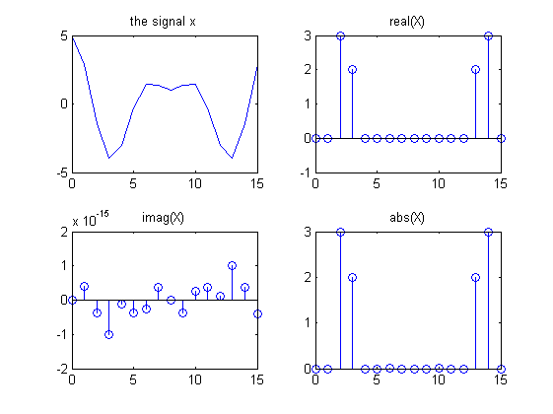
Examples x=3*cos(2*π*2) + 2*cos(2* π*3)

Slide 32
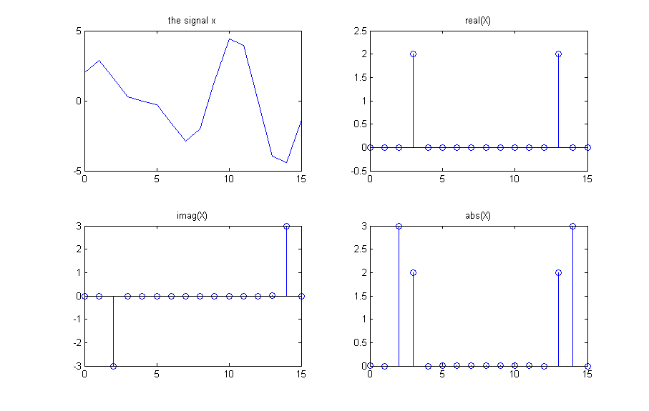
Examples x=3*sin(2*π*2) + 2*cos(2* π*3)

